Slide 1
Introduction to Stream processing on Google Cloud

Slide 2
About me
Andras Palfi
Senior Data Engineer at iScaleIT Solutions
Graduated at the University of Szeged, Business IT
2014 - 2017, Dopti - Java developer, Smart Watch project (Mqtt, Apache Storm, Cassandra, etc.)
2017 - 2021, EPAM Systems - Big Data Software Engineer (Commercial data processing, AWS EMR, Apache Hive, AWS Data Pipeline, Apache Airflow)
2021 - , iScaleIT Solutions - Senior Data Engineer (Stream data processing, Apache Beam, GCP Dataflow, PubSub, BigQuery)
Notes:
regi ceg torol, iscaleit marad

Slide 3
Roadmap
Terminology of Stream processing
Apache Beam
Google Cloud Dataflow
Google Cloud PubSub
Google Cloud BigQuery
Demo Time
Q&A

Slide 4
Terminology

Slide 5
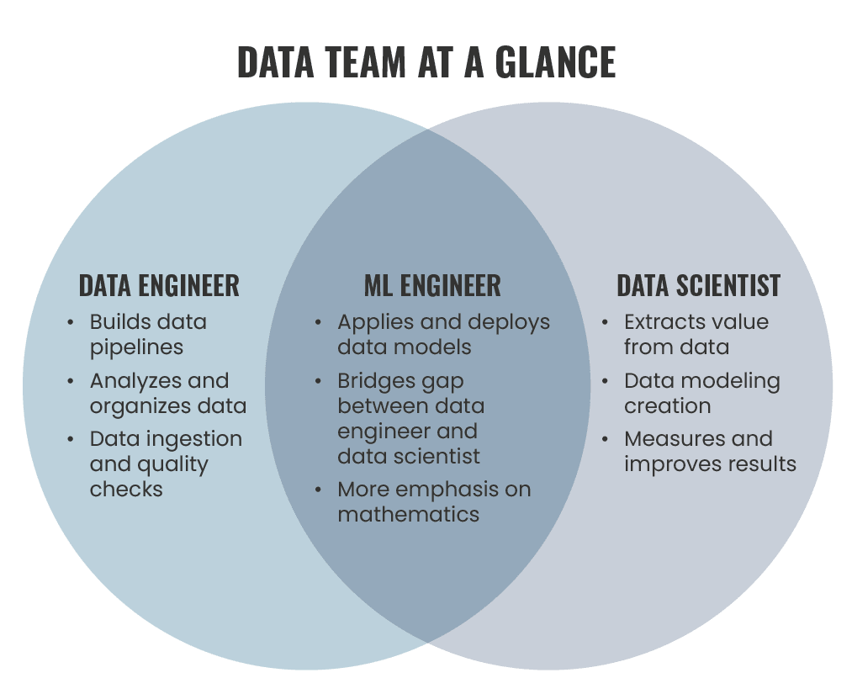
Who are Data Engineers?

Slide 6
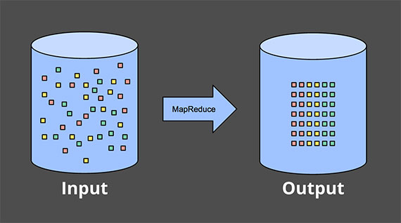
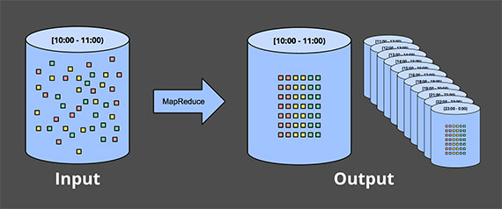
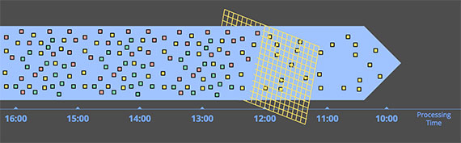
Data processing scenarios
Bounded (batch) data
Daily reporting
Unbounded data — micro batch
Fixed windows
Unbounded data — streaming
Time-agnostic
Time is irrelevant
Web traffic logs filtering
Windowing
Notes:
Unbounded data - batch , engine like Spark Streaming
Unbounded data - streaming, like Dataflow
Micro-batch example: Processing orders from customers on ecommerce websites
Main difference is the velocity

Slide 7
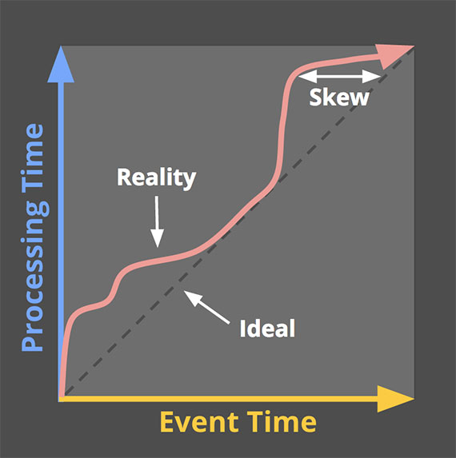
Stream processing in general
Examples
IoT
Computer system and network monitoring
Fraud Detection
Stock Market Analysis
Click Stream
User Behavior Analysis
etc.
Limitations of streaming
Correctness
Event time vs. processing time

Slide 8
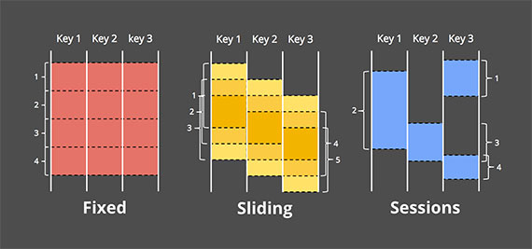
Windowing patterns
Fixed windows
Time into segments with a fixed-size temporal length
Sliding windows
Fixed length and a fixed period
Period is less than the length
E.g.: Running averages of data
Sessions
Sequences of events
Terminated by a gap of inactivity
Unaligned windows
E.g.: User mouse activity

Slide 9
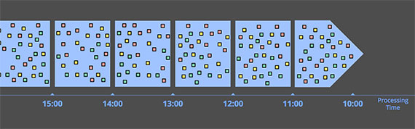
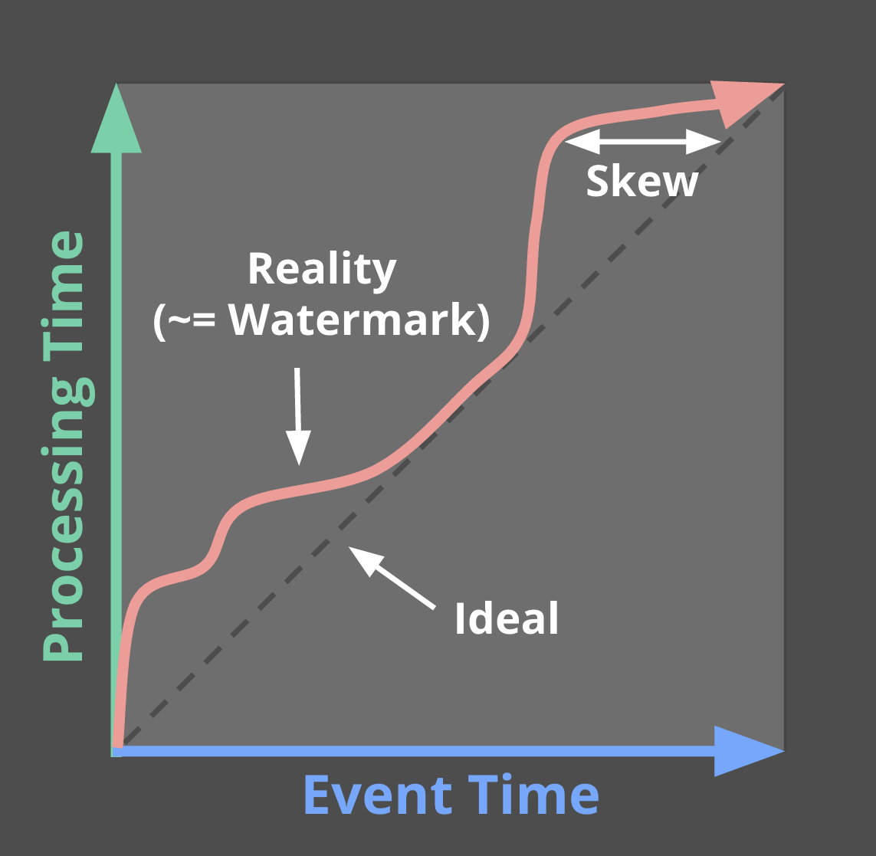
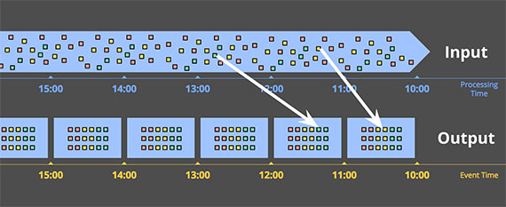
Windowing by processing time
Simple
Completeness is straightforward
No need to deal with “late” data
E.g.: Tracking the number of requests per second
Event time associated with the data makes everything more complicated…
Windowing by event time
Drawbacks:
Buffering
Completeness
Watermarks
Perfect watermarks
Heuristic watermarks
Notes:
Information about the source as it is observed

Slide 10

Apache Beam
Open source, unified model for defining both batch and streaming data-parallel processing pipelines.
Supported languages:
Java
Python
Go
Supported back-ends:
Google Cloud Dataflow
Apache Flink
Apache Spark
Local
Launched in early 2016
Notes:
Spark that misses a lot of triggers’ types
Very quickly, it became apparent to us that the Dataflow model […] is the correct model for stream and batch data processing. […] The Flink Datastream API […] faithfully implements the Beam model
— Kostas Tzoumas, CEO of data Artisans and founder of Apache Flink

Slide 11
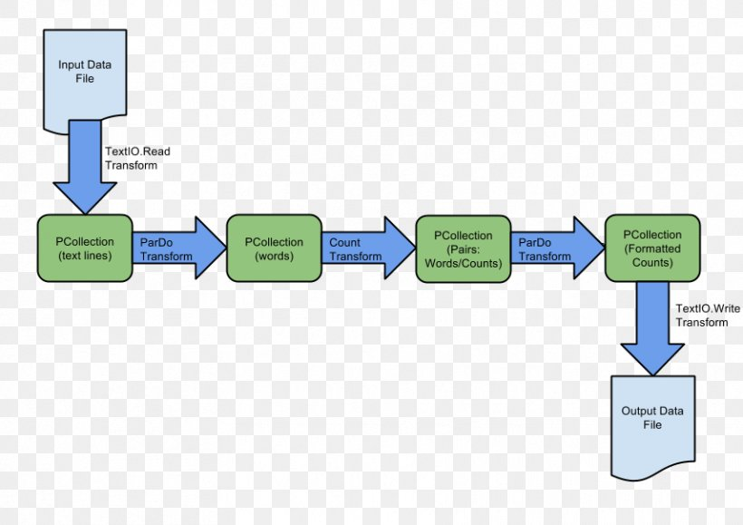
Beam model
Pipeline
Graph (directed acyclic graph)
PCollection
PTransform
Aggregation
User-defined function (UDF)
ParDo, DoFn
CombineFn
Runner
Window
Watermark
Trigger
etc.

Slide 12

Google Cloud Dataflow
Serverless stream and batch data processing engine
Reliable and consistent exactly-once processing

Slide 13
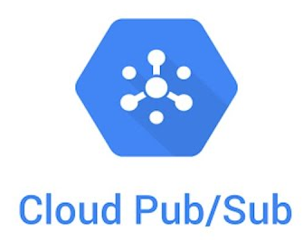
Google Cloud PubSub
Messaging service
Allows services to communicate asynchronously
Pub/Sub is used for streaming analytics and data integration pipelines to ingest and distribute data.
Publishers
Subscribers

Slide 14

Google Cloud BigQuery
Fully-managed, serverless data warehouse
Scalable analysis over petabytes of data
Built-in machine learning capabilities
Notes:
Dremel - scalable, interactive ad hoc query system for analysis
Colossus - cluster-level file system
ColumnIO - columnar file formats

Slide 15
DEMO

Slide 16
Processing Content Feeds to see what matters to users

Slide 17
Q&A

Slide 18
References
Tyler Akidau - https://www.oreilly.com/radar/the-world-beyond-batch-streaming-101/
Tyler Akidau - https://www.oreilly.com/radar/the-world-beyond-batch-streaming-102/
https://beam.apache.org/
https://cloud.google.com/
https://zhuanlan.zhihu.com/p/101111626?fbclid=IwAR0yTl4SHMgzSKfFmQvm2ieecr43u2jw43NAqh_LRMscDapmSEPhsrDBsgc

Slide 19
Thanks for the attention!

